Slide 1

















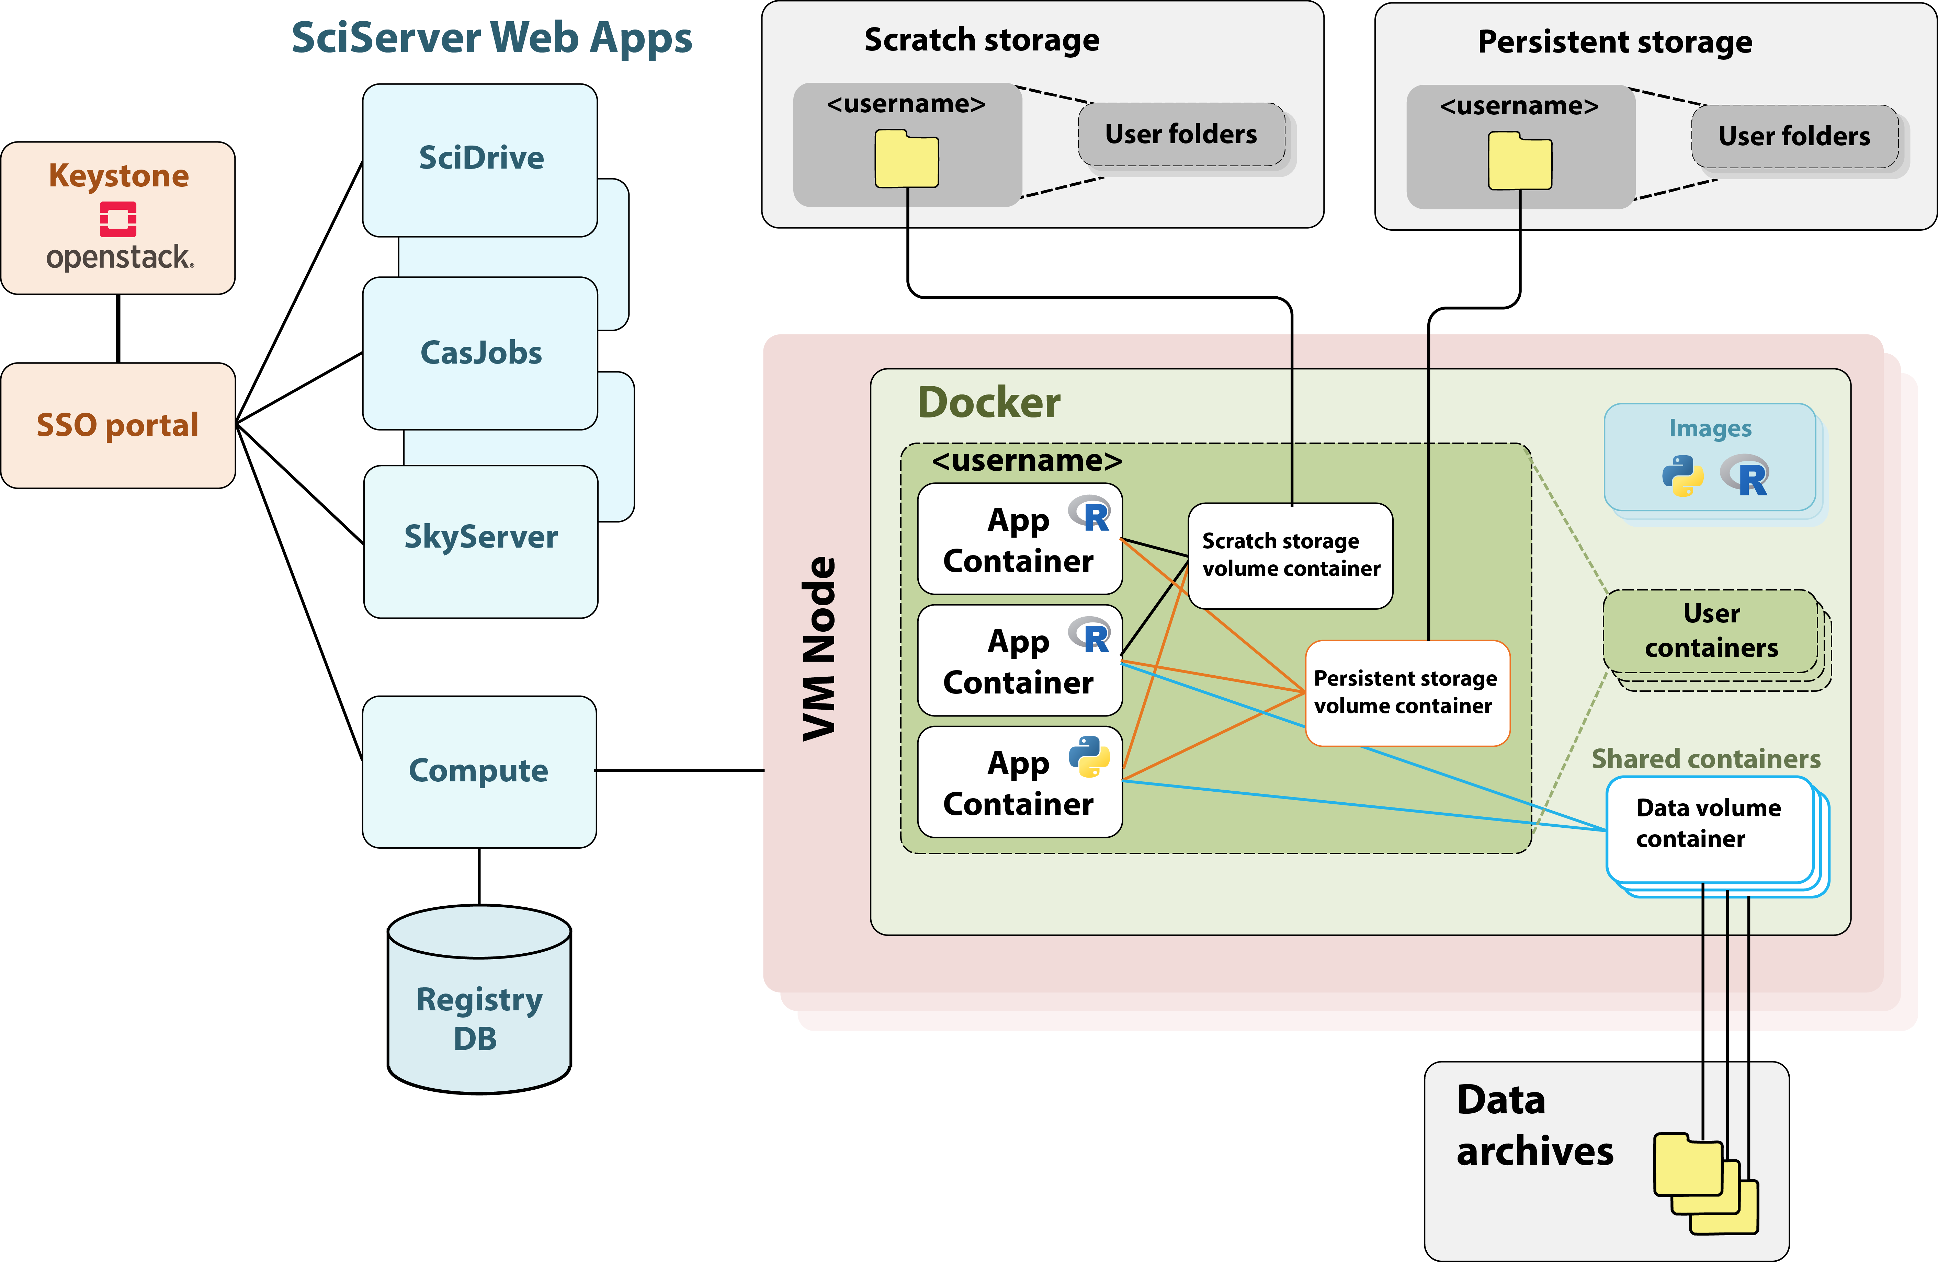
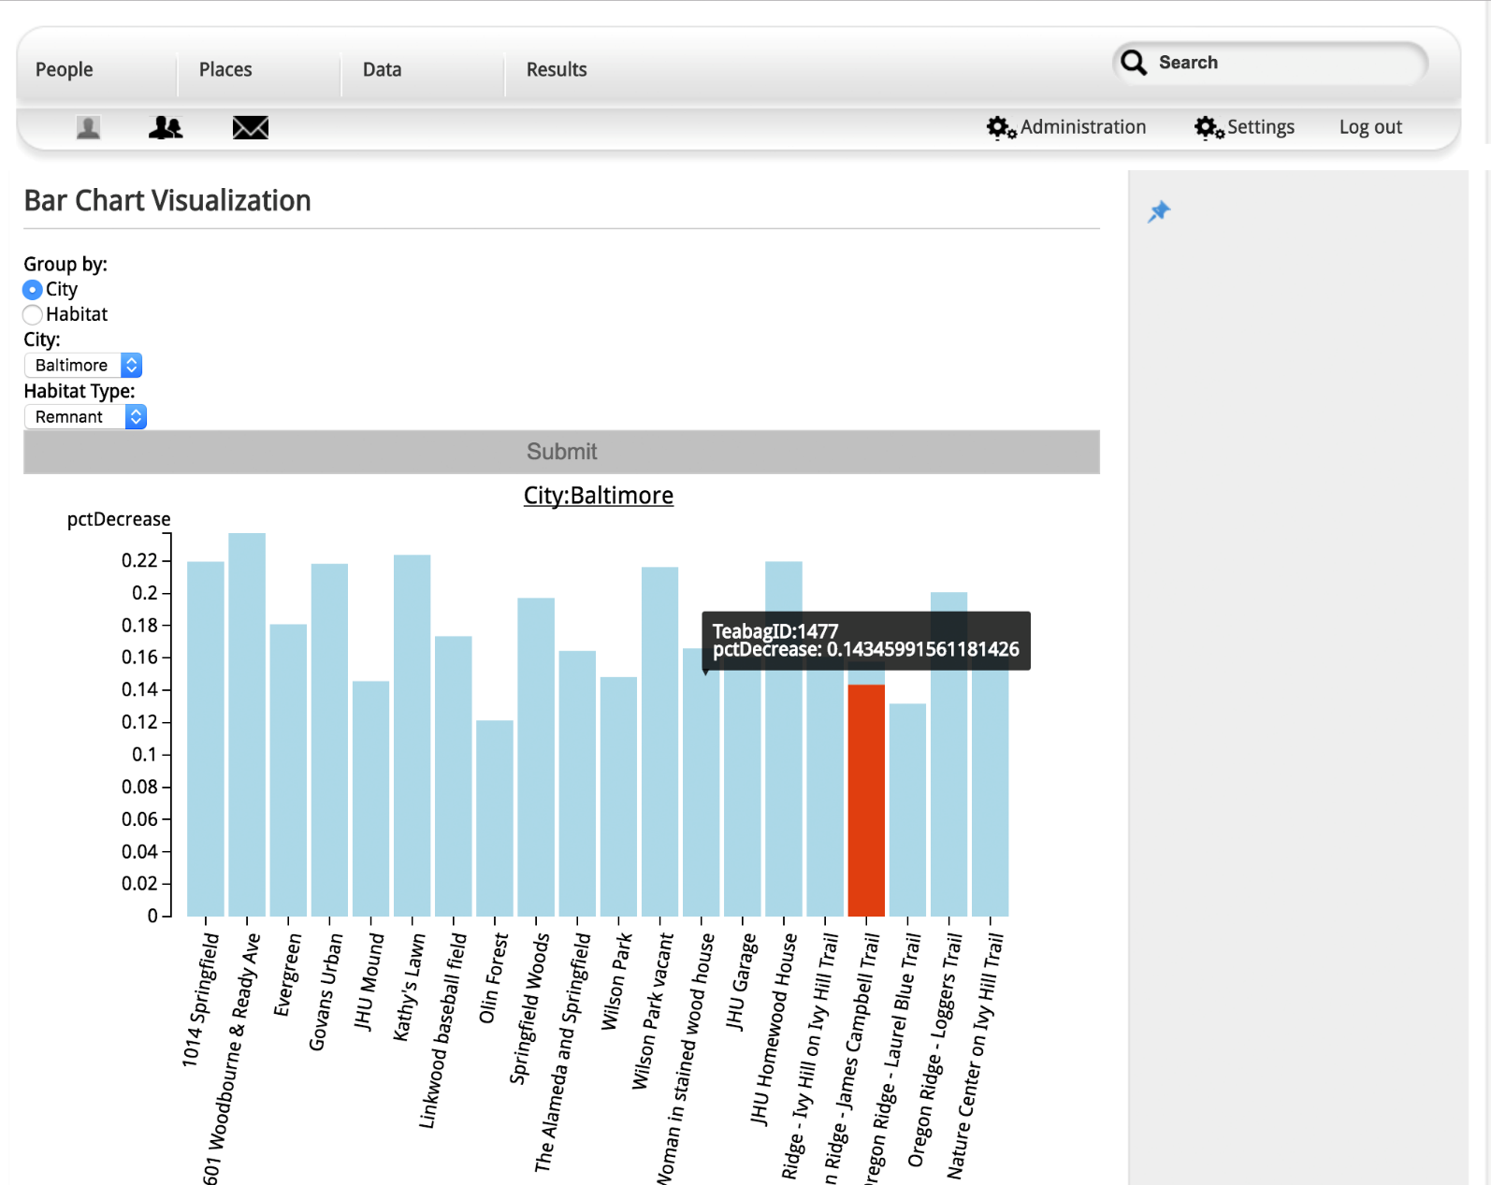
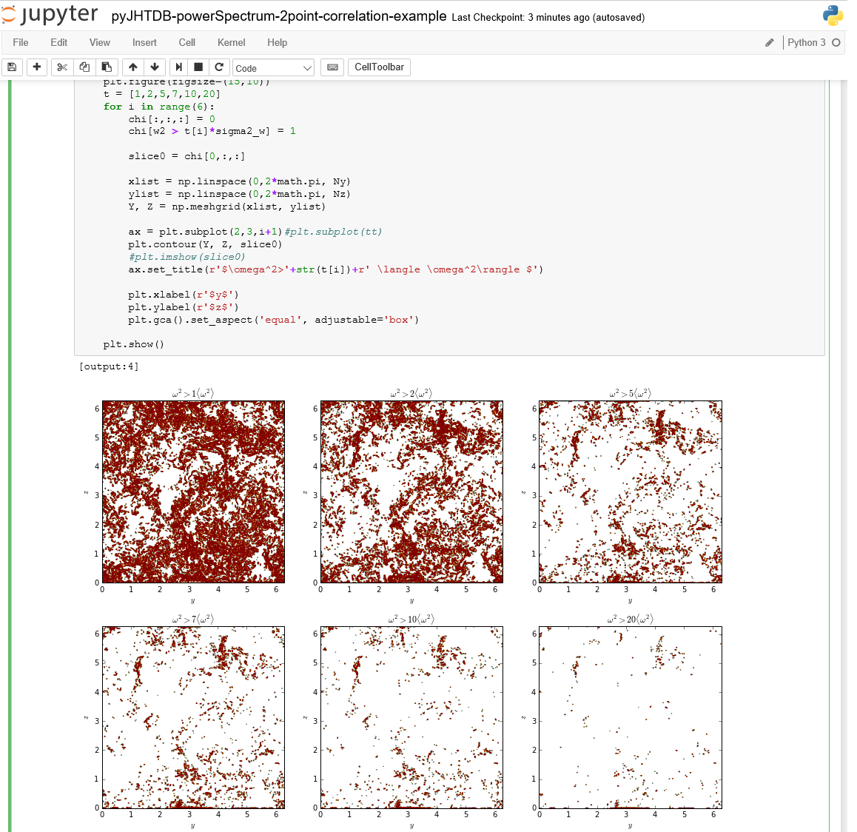
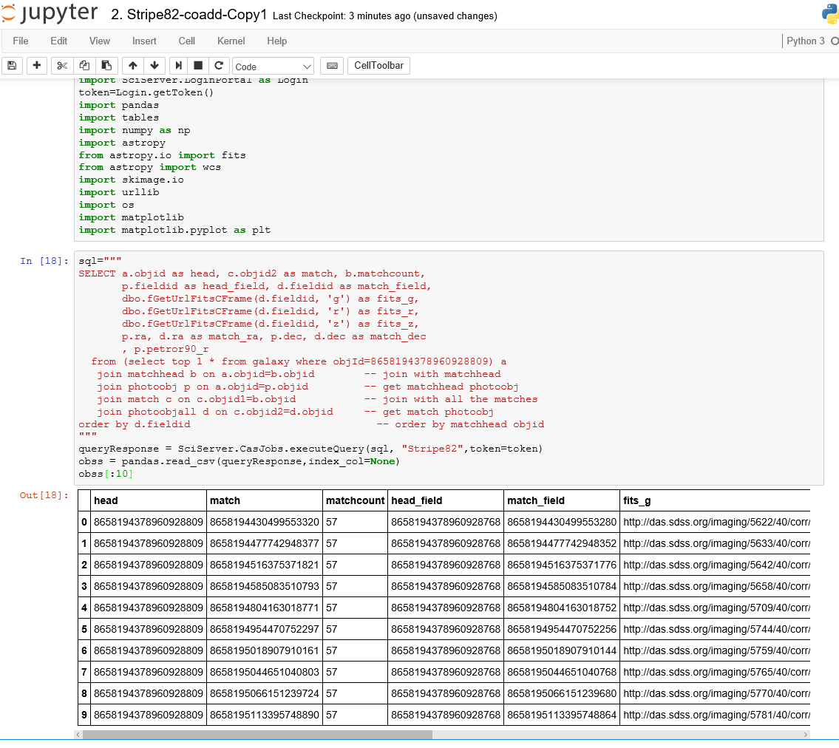
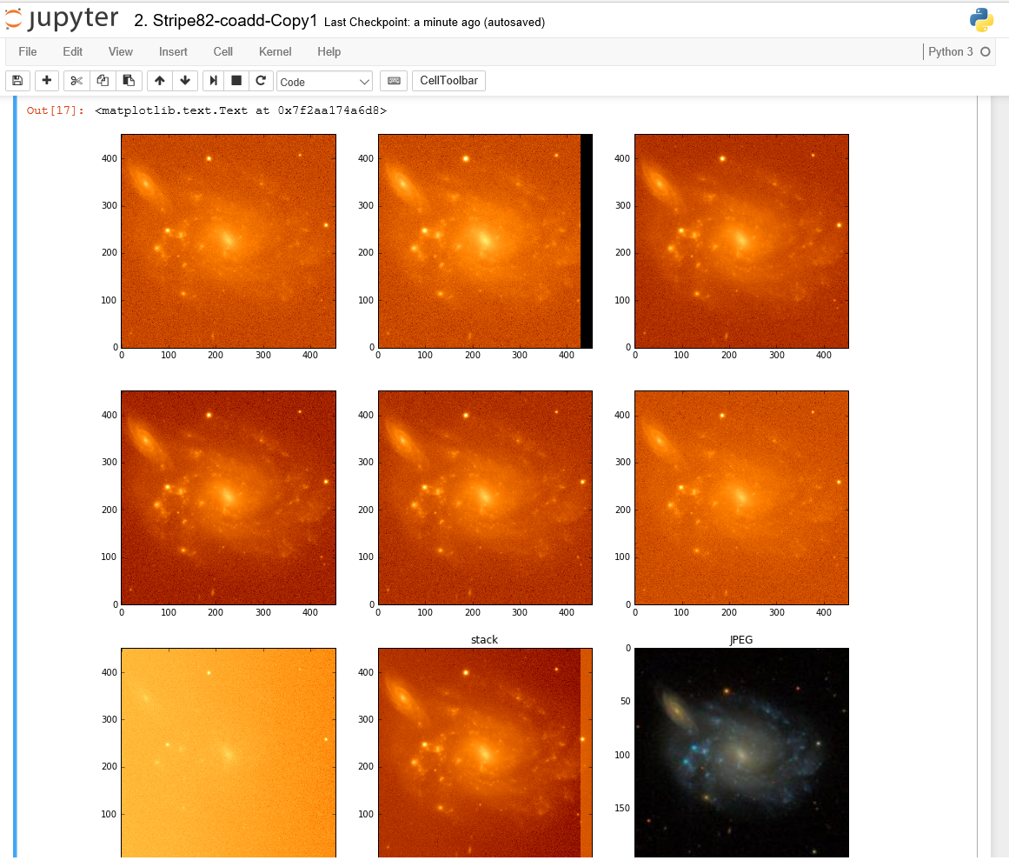
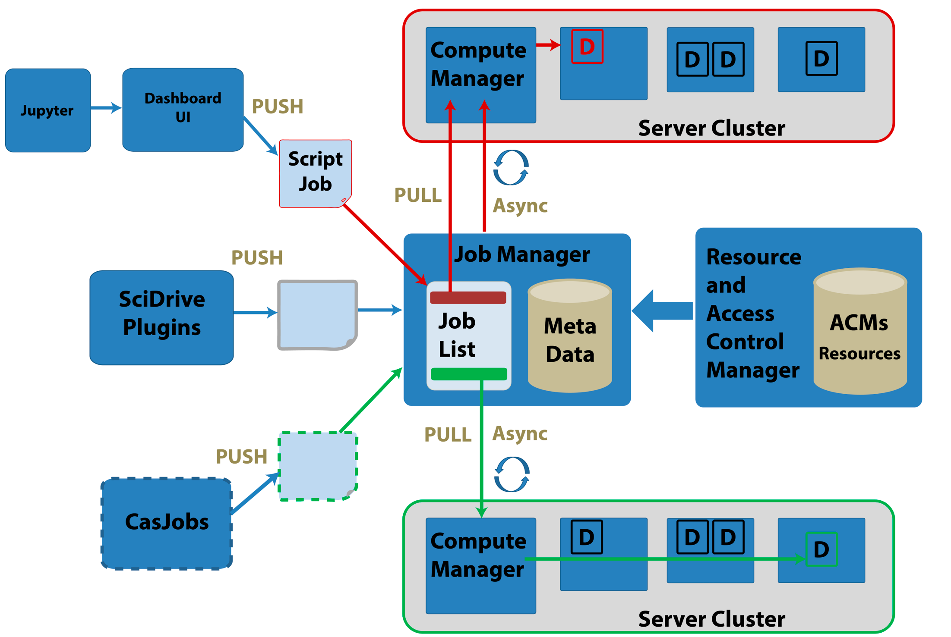
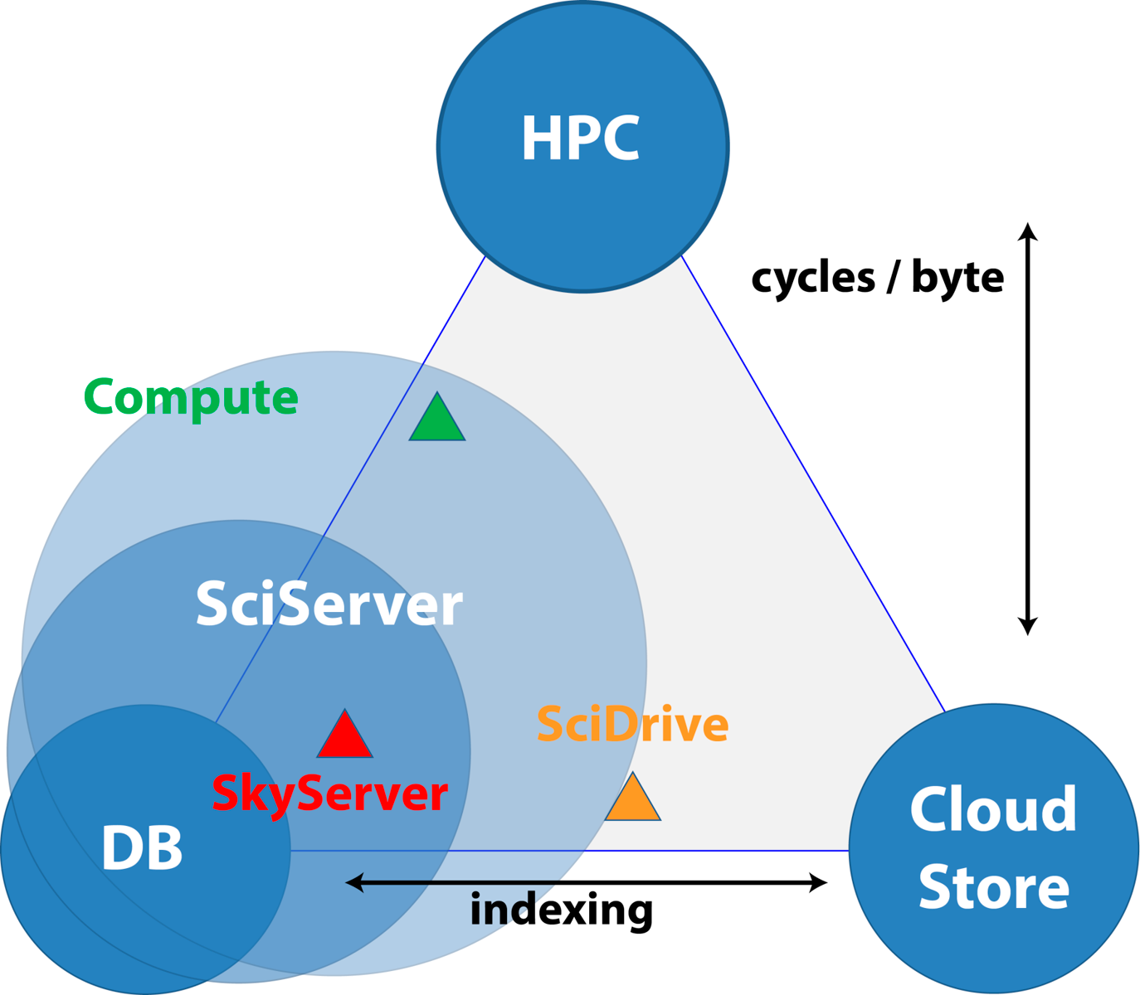
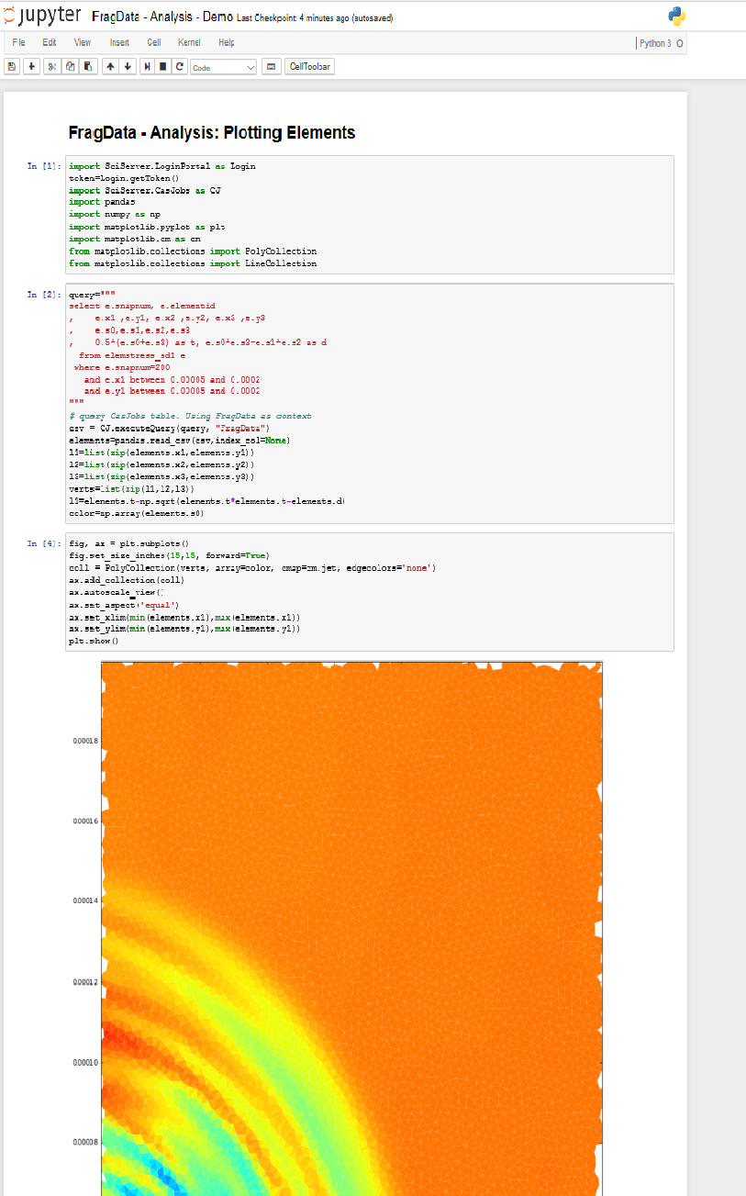
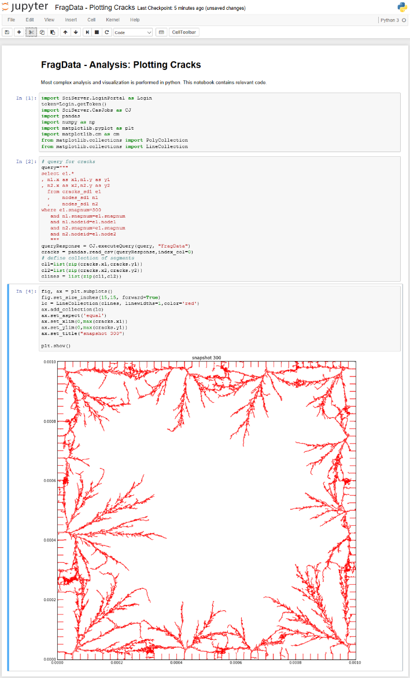
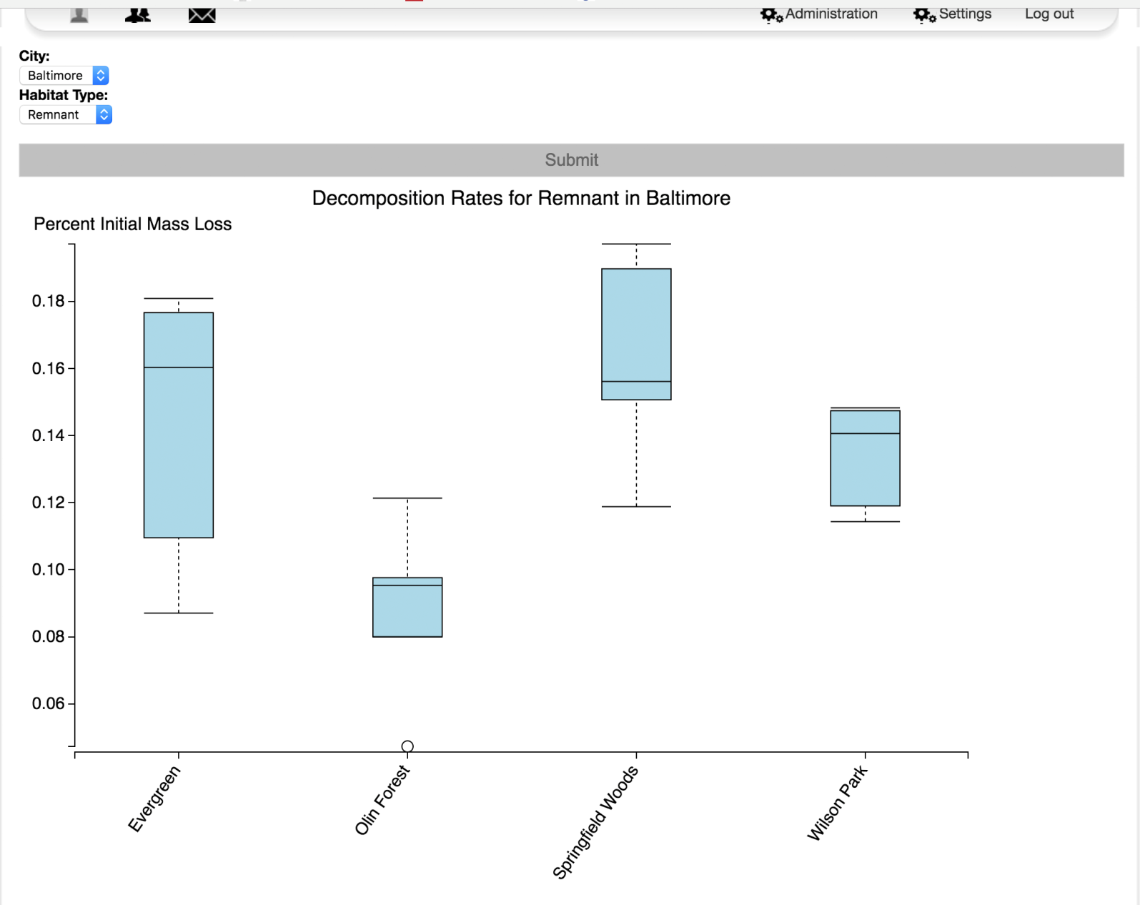
SciServer: Bringing Analysis Close to the Data
PI: Alex Szalay, JHU NSF AWARD No.: 1261715
Team
Technology
Science
PI: Alex Szalay
PM: Mike Rippin
Team Leads: Ani Thakar, Gerard Lemson, Jordan Raddick, Bonnie Souter
Technical: Dmitry Medvedev, Manu Taghizadeh-Popp, Jai Won Kim, Sue Werner, Victor Paul, Jan Vandenberg, Lance Joseph, Alainna White, Laszlo Dobos
Collaborations
Current System
Oceanography
Genomics
Astronomy
Materials Science
Cosmology
Turbulence
Environmental Science
New Science
Database storage & Query:
Data analysis:
File storage:
Data exploration:
User sign-on:
History and Motivation
Compute
Applications
Origin: Sloan Digital Sky Survey’s SkyServer
Goal: Access rich content instantly
Idea: Bring the analysis to the data
Core Function: Collaborative Research Environment
Environmental Science
Next Steps
Interactive science on Petabyte-scale data
Create scalable open numerical laboratories
Large footprint across many disciplines
Use commonly shared building blocks
Major national and international impact
Astronomy
Compute Job Scheduling
System Balance
Materials Science
Turbulence

